Slide 1
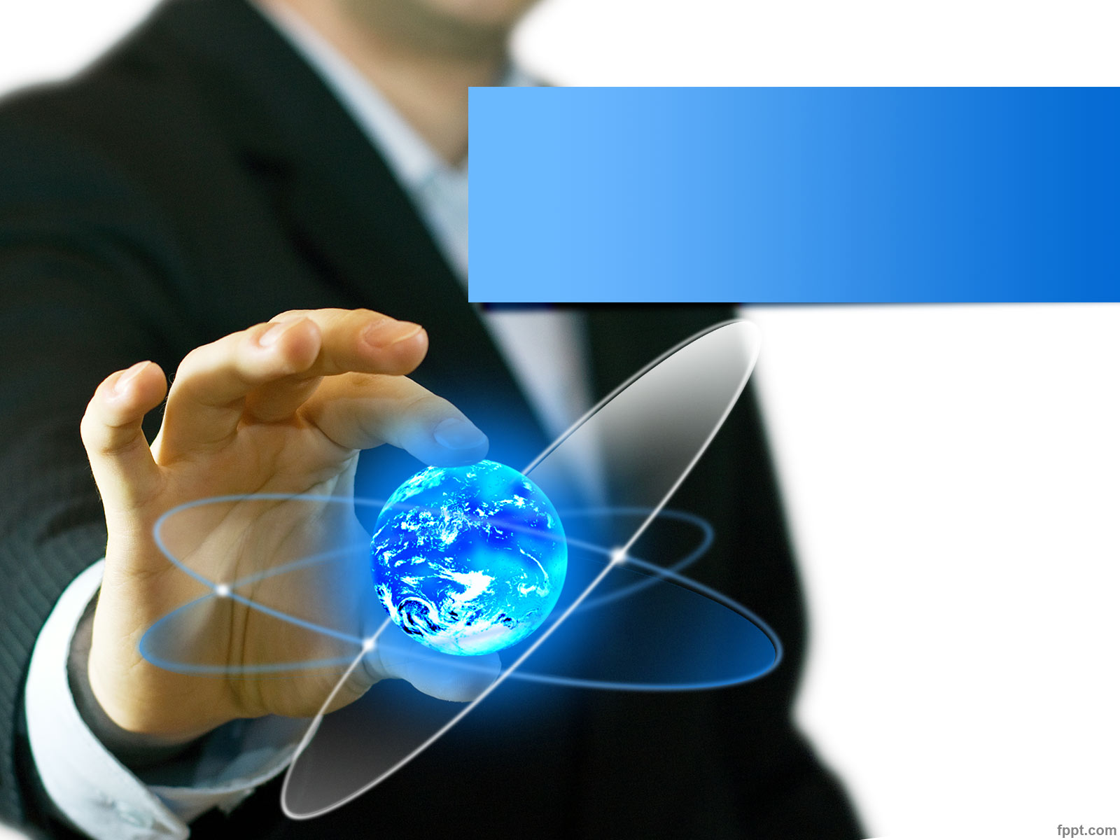
Lecture 2: Introduction to Information Technology
Hoger Mahmud

Slide 2

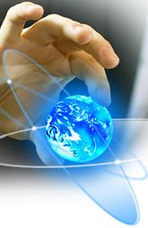

Lecture outline
Information
Information technology
Computers
Processing cycle
Future of Information Technology
IT job titles
2

Slide 3
Information
Information: processed and ordered individual pieces of information that is meaningful to human.
Methods to convey Information
Text
Image
Sound
Numbers
3

Slide 4
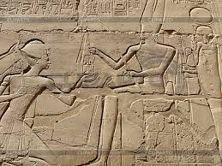
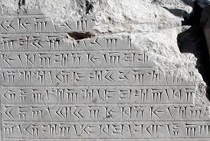
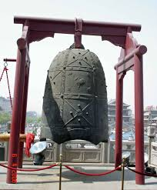
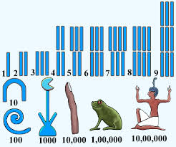
Conveying information in past
Image
Text
Sound
Numbers
4

Slide 5
Valuable Information Characteristics
Accessible: information should be easily accessible by authorized user
Accurate: Information should be free of errors and correct
Complete: Information should contain all important facts required to be useful
Economical: Information should be cheap to produce
Relevant: Information should be related to the topic that the information is about
5

Slide 6
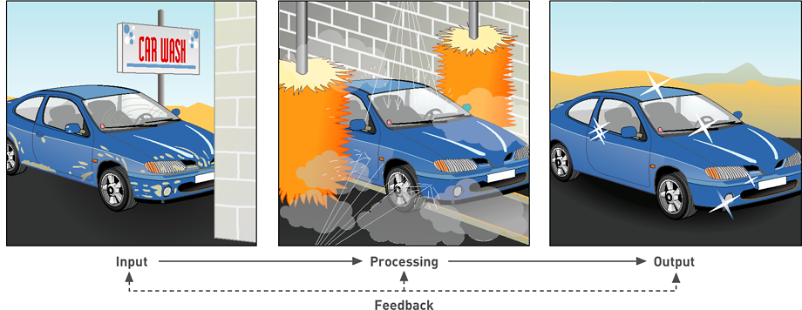
Concepts of System
System: A set of components that work together and interact to accomplish predefined goals.
6

Slide 7
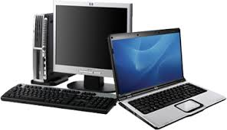
Information Technology
Information Technologies are systems of hardware and software that:
Capture (input)
process (Process)
exchange
store and/or present information (out put)
Systems
Process
input
Output
7

Slide 8
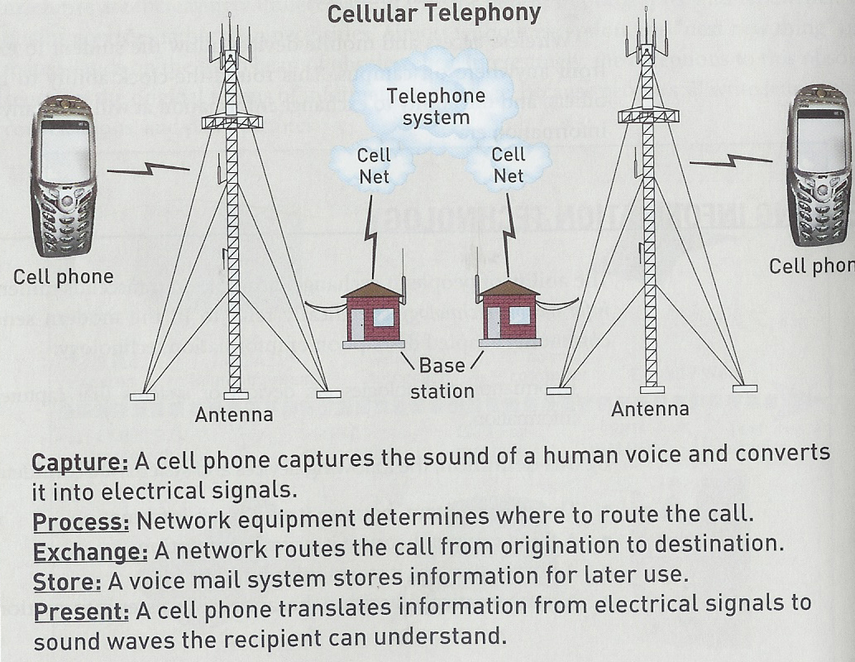
IT example
Capture: cell phone captures human voice and convert it into electrical signal
Process: Network equipment determine where to routes the call
Exchange: Network routes the call form original to destination
Store: A voice mail system stores the information for later use
Present: cell phone convert signal to understandable sound
8

Slide 9
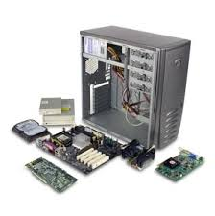
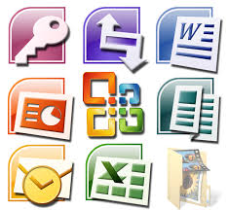
System components
Hardware
Mechanical devices in the computer
Anything that can be touched
Software
Tell the computer what to do
Also called a program
Thousands of programs exist
Some for computer’s own use
Some for the service of the user
9

Slide 10
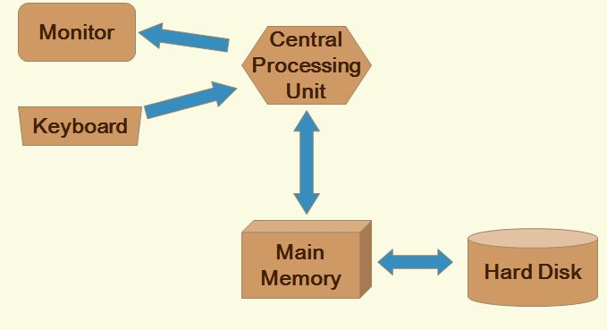
Computer System
10

Slide 11
Information processing cycle
Input
Storage
Process
Output
11

Slide 12
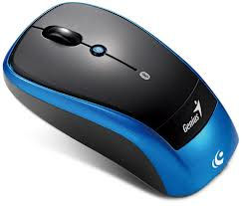
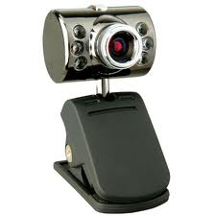
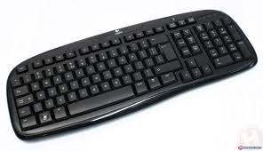
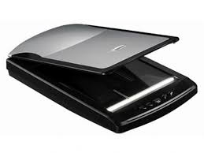
Input
Input Device: A device by which input is fed into a computer’s central processor.
Examples:
Keyboard
Mouse
Camera
Scanner
Microphone
12

Slide 13
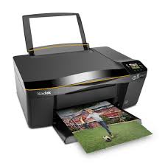
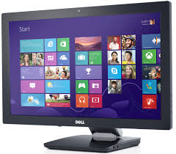
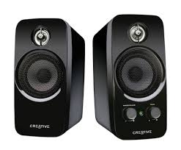
Output
Output Device: A device that makes the results of processing available to the user
Examples:
Monitor
Speaker
Printer
13

Slide 14
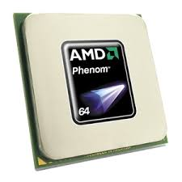
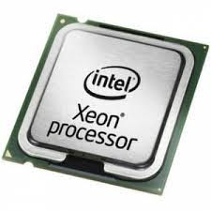
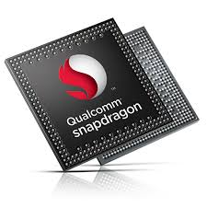
Processor
Processor: perform actions on the data based on instructions from user or program
Processor chip: A tiny piece of silicon that contains millions of miniature electronic circuits
14

Slide 15
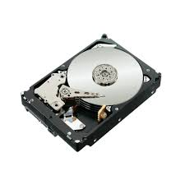
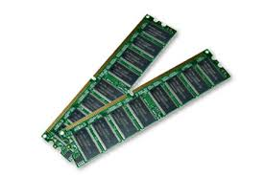
Storage
Storage: The area in the computer where data or information is held permanently
Memory: Computer circuitry that temporarily holds data waiting to be processed
Storage capacity is represented in:
1 byte - 1 character of data.
1 kilobyte – 210 bytes/char; 1,024 characters.
1 megabyte - 220 bytes/char 1,048,576 characters.
1 gigabyte - more than 1 billion characters.
1 terabyte - more than 1 trillion characters
15

Slide 16
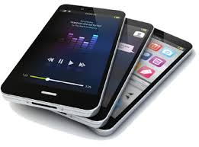
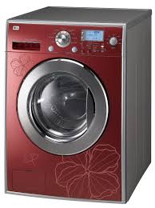
Computers are everywhere
Not just Desktops, Workstations, Tablet PCs, Servers, Mainframe computers, Minicomputers
But also…
Cell phones
Alarm Clocks
Microwave Ovens
Lighting control in a building
Washing Machines
16

Slide 17
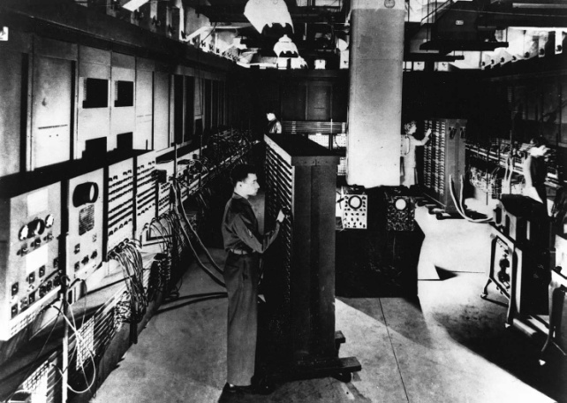
Future of Information Technology
Information Technologies are developed in three directions:
Miniaturisation: making systems more compact and easier to transfer
Speed: making systems faster in processing data
Affordability: making systems cheaper to buy
17

Slide 18
Examples of IT Careers
IT Analyst
Translate business requirement into technical specification
Network Administration
Configure and operate computer network
Management Consulting
Provide consulting for government and organizations
Database Administration
Managing corporate database
Computer Forensics Expert
Extracts computer evidence for detecting/preventing /prosecuting crimes
IT Sales:
people on frontline to sell products
Software development:
develop software solutions
18

Slide 19
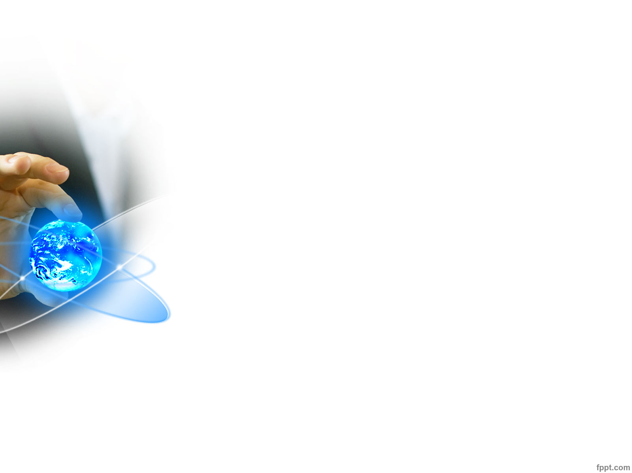
Thank you
?

